Slide 1

Denavit-Hartenberg Parameters (standardized frame)
by Sarot SRANG

Slide 2















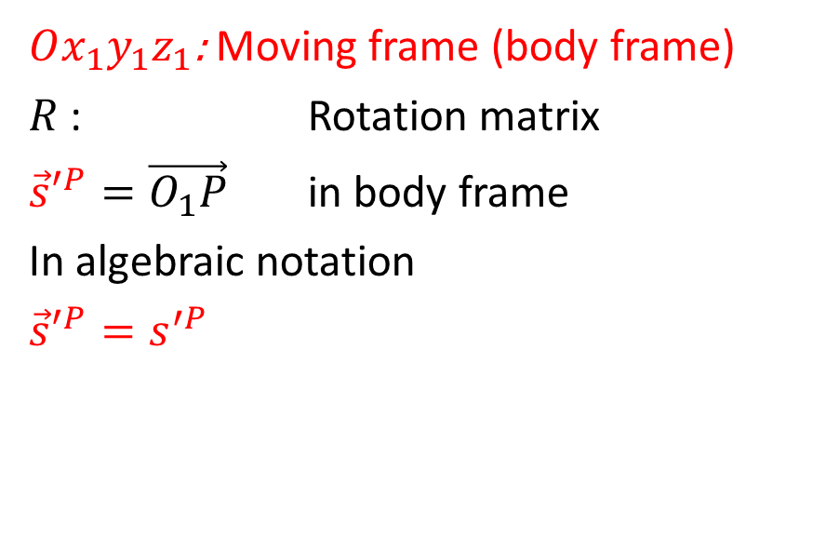




$Oxyz$: Fixed frame (global frame)
$R$ : Rotation matrix
${\vec{r}}^{P}=\vec{OP}$ in fixed frame
${\vec{s}}^{P}=\vec{O_{1}P}$ in fixed frame
In algebraic notation
${\vec{r}}^{P}=r^{P}$
${\vec{s}}^{P}=s^{P}$
$Ox_{1}y_{1}z_{1}$: Moving frame (body frame)
$R$ : Rotation matrix
${\vec{s}′}^{P}=\vec{O_{1}P}$ in body frame
In algebraic notation
${\vec{s}′}^{P}=s^{′P}$
$$z$$
$$R$$
$$z_{1}$$
$$P$$
$$y_{1}$$
$$z$$
$$O_{1}$$
$$y$$
$$r^{P}$$
$$x_{1}$$
$$s^{′P}$$
$$r$$
$$x$$
$$y$$
$$O$$
$$s^{P}=Rs^{′P}$$
$$r^{P}=r+Rs^{′P}$$
$$x$$

Slide 3

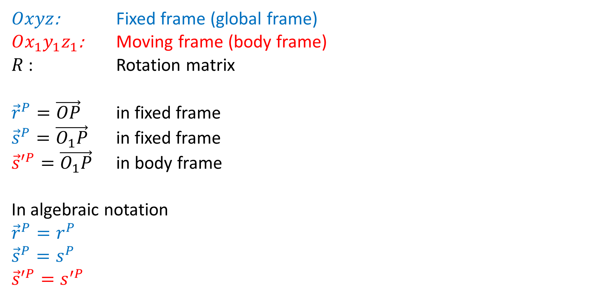






Coordinate Transformation (review)
$$z$$
$$R$$
$$z_{1}$$
$Oxyz$: Fixed frame (global frame)
$Ox_{1}y_{1}z_{1}$: Moving frame (body frame)
$R$ : Rotation matrix
${\vec{r}}^{P}=\vec{OP}$ in fixed frame
${\vec{s}}^{P}=\vec{O_{1}P}$ in fixed frame
${\vec{s}′}^{P}=\vec{O_{1}P}$ in body frame
In algebraic notation
${\vec{r}}^{P}=r^{P}$
${\vec{s}}^{P}=s^{P}$
${\vec{s}′}^{P}=s^{′P}$
$$P$$
$$y_{1}$$
$$z$$
$$O_{1}$$
$$y$$
$$r^{P}$$
$$x_{1}$$
$$s^{′P}$$
$$r$$
$$x$$
$$y$$
$$O$$
$$x$$
$$s^{P}=Rs^{′P}$$
$$r^{P}=r+Rs^{′P}$$

Slide 4





Coordinate Transformation (review)
$$z$$
$$R$$
Expanded form
$\left[\begin{matrix}x^{P} \\ y^{P} \\ z^{P}\end{matrix}\right]=\left[\begin{matrix}x \\ y \\ z\end{matrix}\right]+\left[\begin{matrix}r_{11} & r_{12} & r_{13} \\ r_{21} & r_{22} & r_{23} \\ r_{31} & r_{32} & r_{33}\end{matrix}\right]\left[\begin{matrix}x_{1}^{P} \\ y_{1}^{P} \\ z_{1}^{P}\end{matrix}\right]$
$$r^{P}=r+Rs^{′P}$$
$$z_{1}$$
$$y_{1}$$
$$P$$
$$z$$
$$O_{1}$$
$$y$$
$$r^{P}$$
$$r$$
$$x_{1}$$
$$x$$
$$y$$
$$O$$
$$x$$

Slide 5



Homogeneous transformation
Can we write the coordinate transformation from body frame to global frame using a “Systematic Matrix”?
Yes, the “Systematic Matrix”
is called
“Homogeneous transformation Matrix”
$$r^{P}=r+Rs^{′P} \\ =\left[\begin{matrix}R & ?\end{matrix}\right]\left[\begin{aligned}s^{′P} \\ ?\end{aligned}\right]$$
$$r^{P}=r+Rs^{′P} \\ =\left[\begin{matrix}R & r\end{matrix}\right]\left[\begin{aligned}s^{′P} \\ 1\end{aligned}\right]$$
If we want to find $s^{′P}$, does $\left[\begin{matrix}R & r\end{matrix}\right]$ have inverse?
NO!

Slide 6



Homogeneous transformation
“Homogeneous transformation Matrix”
$$r^{P}=r+Rs^{′P} \\ =\left[\begin{matrix}R & r\end{matrix}\right]\left[\begin{aligned}s^{′P} \\ 1\end{aligned}\right]$$
$$\left[\begin{aligned}r^{P} \\ 1\end{aligned}\right]=\left[\begin{aligned}r+Rs^{′P} \\ 1\end{aligned}\right] \\ =\left[\begin{aligned}\begin{matrix}R & r\end{matrix} \\ \begin{matrix}0^{T} & 1\end{matrix}\end{aligned}\right]\left[\begin{aligned}s^{′P} \\ 1\end{aligned}\right]$$
What if
Does $\left[\begin{aligned}\begin{matrix}R & r\end{matrix} \\ \begin{matrix}0^{T} & 1\end{matrix}\end{aligned}\right]$ has inverse?
Yes!

Slide 7












Homogeneous Transformation
$$\{b\}$$
(1) Represent a configuration
$T_{sb}=\left[\begin{matrix}R_{sb} & r \\ 0^{T} & 1\end{matrix}\right]$
where $0^{T}=\left[\begin{matrix}0 & 0 & 0\end{matrix}\right]$. Then
$\left[\begin{matrix}r^{P} \\ 1\end{matrix}\right]=\left[\begin{matrix}R_{sb} & r \\ 0^{T} & 1\end{matrix}\right]\left[\begin{matrix}s^{′P} \\ 1\end{matrix}\right]=\left[\begin{matrix}R_{sb}s^{′P}+r \\ 1\end{matrix}\right]$
$T_{bs}=T_{sb}^{−1}=\left[\begin{matrix}R_{sb}^{T} & −R_{sb}^{T}r \\ 0^{T} & 1\end{matrix}\right]$
$$r$$
Translation
$$\{s\}$$
$$z$$
$$R$$
Rotation
$$z_{1}$$
$$y_{1}$$
$$P$$
$$z$$
$$O_{1}$$
$$y$$
$$r^{P}$$
$$r$$
$$x_{1}$$
$$x$$
$$y$$
$$O$$
$$x$$

Slide 8













Homogeneous Transformation
$$\{b\}$$
(2) Change reference frame
$T_{sc}=T_{sb}T_{bc}$
$T_{cs}=T_{sc}^{−1}=T_{bc}^{−1}T_{sb}^{−1}$
$p_{s}=T_{sb}p_{b}$ ($T_{sb}∈R^{4×4}, p_{b}∈R^{3×1}$)
$\left[\begin{matrix}p_{s} \\ 1\end{matrix}\right]=T_{sb}\left[\begin{matrix}p_{b} \\ 1\end{matrix}\right]$
$$T_{sb}$$
$$\{s\}$$
$$T_{bc}$$
$$T_{sc}$$
$$\{c\}$$
$$?$$
$$P$$
$$\{b\}$$
$$p_{b}$$
Homogeneous Coordinate
Transformation
$$p_{s}$$
$$\{s\}$$

Slide 9
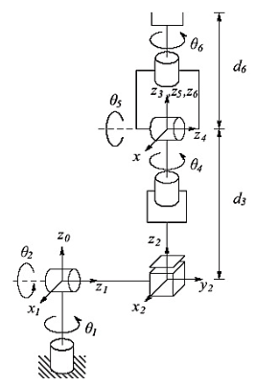
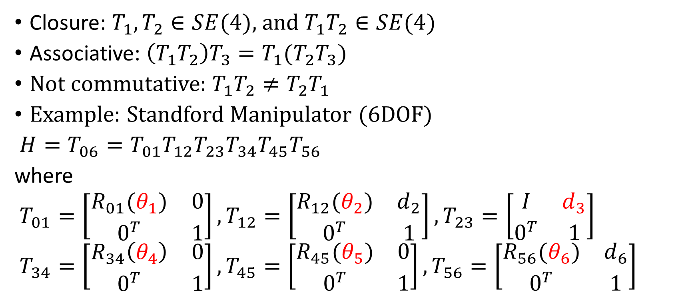
Homogeneous Transformation
Closure: $T_{1},T_{2}∈SE(4)$, and $T_{1}T_{2}∈SE(4)$
Associative: $\left(T_{1}T_{2}\right)T_{3}=T_{1}(T_{2}T_{3})$
Not commutative: $T_{1}T_{2}≠T_{2}T_{1}$
Example: Standford Manipulator (6DOF)
$H=T_{06}=T_{01}T_{12}T_{23}T_{34}T_{45}T_{56}$
where
$T_{01}=\left[\begin{matrix}R_{01}(θ_{1}) & 0 \\ 0^{T} & 1\end{matrix}\right], T_{12}=\left[\begin{matrix}R_{12}(θ_{2}) & d_{2} \\ 0^{T} & 1\end{matrix}\right], T_{23}=\left[\begin{matrix}I & d_{3} \\ 0^{T} & 1\end{matrix}\right]$
$T_{34}=\left[\begin{matrix}R_{34}\left(θ_{4}\right) & 0 \\ 0^{T} & 1\end{matrix}\right], T_{45}=\left[\begin{matrix}R_{45}(θ_{5}) & 0 \\ 0^{T} & 1\end{matrix}\right], T_{56}=\left[\begin{matrix}R_{56}(θ_{6}) & d_{6} \\ 0^{T} & 1\end{matrix}\right]$

Slide 10
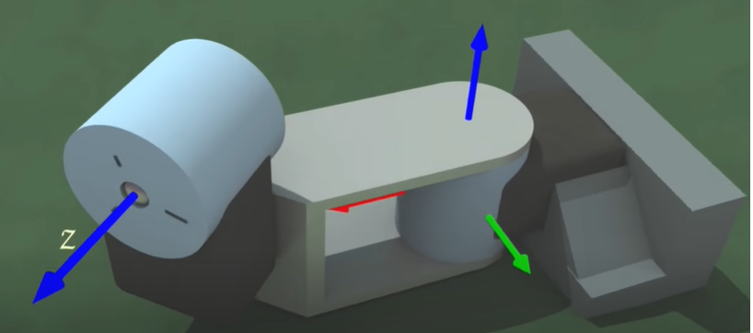

Denavit-Hartenberg Concept
https://www.youtube.com/watch?v=rA9tm0gTln8
(This video does not have enough information)
Rule 0: there must be a base frame $\left(Ox_{0}y_{0}z_{0}\right)$
Rule 1: Z axis must be on the direction of moving vector

Slide 11
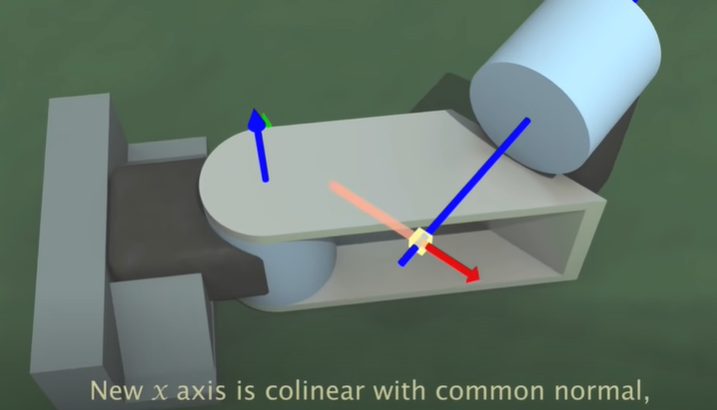

Denavit-Hartenberg Concept
Rule 2: $x_{i−1}$ axis lies along common normal between $z_{i−1}$and $z_{i}$

Slide 12

Denavit-Hartenberg Concept
Rule 3: $x_{i}$ intercept $z_{i−1}$ at 0 initial position of revolute joint $i$

Slide 13
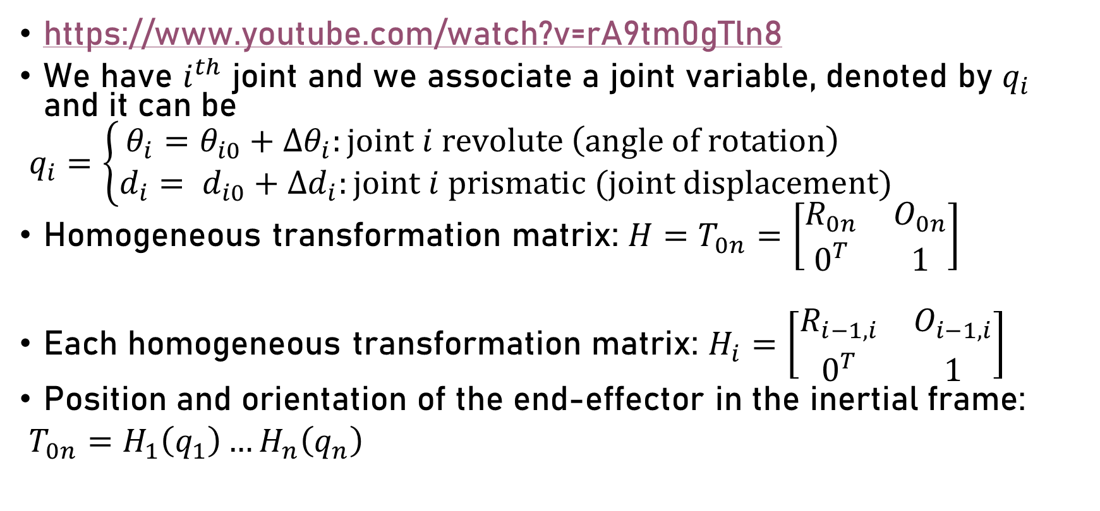
Denavit-Hartenberg Concept
https://www.youtube.com/watch?v=rA9tm0gTln8
We have $i^{th}$ joint and we associate a joint variable, denoted by $q_{i}$ and it can be
$q_{i}=\left\{\begin{aligned}θ_{i}=θ_{i0}+Δθ_{i}:joint i revolute \left(angle of rotation\right) \\ d_{i}= d_{i0}+Δd_{i}:joint i prismatic (joint displacement)\end{aligned}\right.$
Homogeneous transformation matrix: $H=T_{0n}=\left[\begin{matrix}R_{0n} & O_{0n} \\ 0^{T} & 1\end{matrix}\right]$
Each homogeneous transformation matrix: $H_{i}=\left[\begin{matrix}R_{i−1,i} & O_{i−1,i} \\ 0^{T} & 1\end{matrix}\right]$
Position and orientation of the end-effector in the inertial frame:
$T_{0n}=H_{1}\left(q_{1}\right)…H_{n}\left(q_{n}\right)$

Slide 14
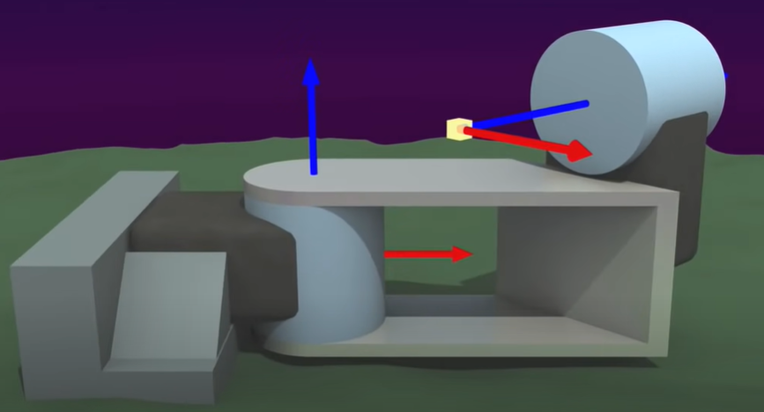
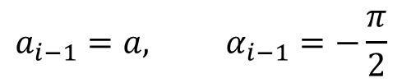



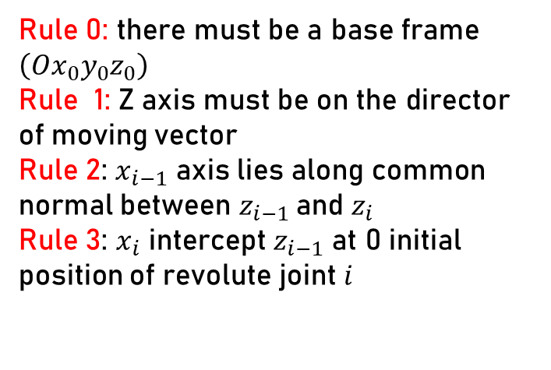

Denavit-Hartenberg Parameters
$a_{i−1}$: link length (displacement along $x_{i−1}$ from $parent frame to child frame$)
$α_{i−1}$: link twist (rotation around $x_{i−1}$ from $z_{i−1}$ to $z_{i}$)
Frame 0 → 1
$a_{i−1}=0, α_{i−1}=0$
Rule 0: there must be a base frame $\left(Ox_{0}y_{0}z_{0}\right)$
Rule 1: Z axis must be on the director of moving vector
Rule 2: $x_{i−1}$ axis lies along common normal between $z_{i−1}$and $z_{i}$
Rule 3: $x_{i}$ intercept $z_{i−1}$ at 0 initial position of revolute joint $i$
Frame 1 → 2
$$a_{i−1}=a, α_{i−1}=−\frac{π}{2}$$

Slide 15










Denavit-Hartenberg Parameters
$d_{i}$: link length (displacement along $z_{i}$ from $x_{i−1}$ to $x_{i}$)
$θ_{i}$: link twist (rotation around $z_{i}$ from $x_{i−1}$ to $x_{i}$)
Frame 0 → 1
$$a_{i−1}=0, α_{i−1}=0, d_{i}=d, θ_{i}=θ_{1,0}+Δθ_{1}$$
$$a_{i−1}=a, α_{i−1}=−\frac{π}{2}, d_{i}=0, θ_{i}=0+Δθ_{2}$$
Frame 1 → 2

Slide 16
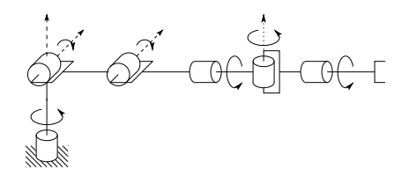

























Denavit-Hartenberg Parameters
$a_{i−1}$: link length (displacement along $x_{i−1}$ from $parent to child$)
$α_{i−1}$: link twist (rotation around $x_{i−1}$ from $z_{i−1}$ to $z_{i}$)
$d_{i}$: link offset (displacement along $z_{i}$ from $x_{i−1}$to $x_{i}$)
$θ_{i}$: joint angle (rotation around $z_{i}$ from $x_{i−1}$to $x_{i}$)
$$z_{1}$$
$$z_{5}$$
Rule 0: there must be a base frame $\left(Ox_{0}y_{0}z_{0}\right)$
Rule 1: Z axis must be on the direction of moving vector
Rule 2: $x_{i−1}$ axis lies along common normal between $z_{i−1}$and $z_{i}$
Rule 3: $x_{i}$ intercept $z_{i−1}$ at 0 initial position of revolute joint $i$
$$θ_{2}$$
$$z_{2}$$
$$x_{3,4}$$
$$z_{3}$$
$$θ_{5}$$
$$θ_{3}$$
$$O_{7}$$
$$x_{1,2}$$
$$z_{4}$$
$$θ_{4}$$
$$z_{4′,6}$$
$$l_{2}$$
$$z_{7}$$
$$l_{4}$$
$$l_{6}$$
$$x_{7}$$
$$l_{1}$$
$$θ_{1}$$
$$x_{4′,5,6}$$
$$z_{0}$$
$$x_{0}$$

Slide 17





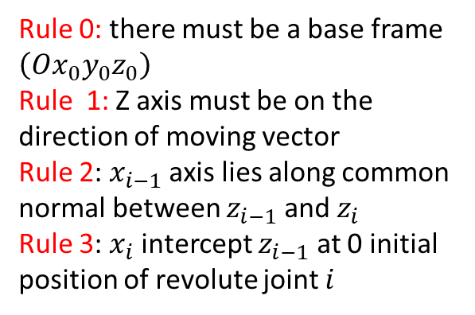




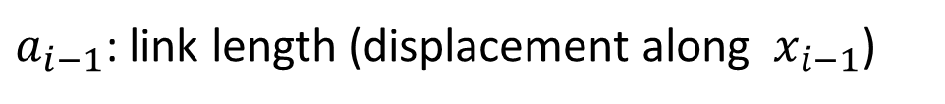



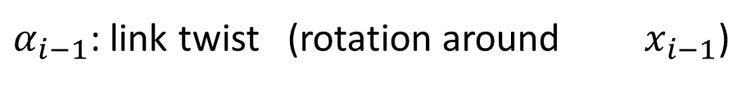




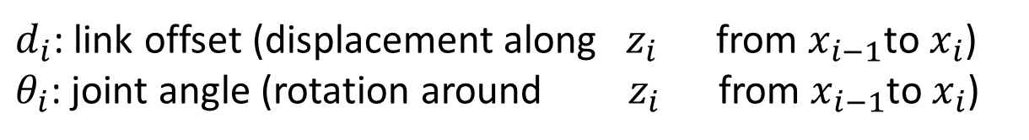













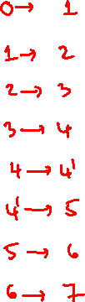


$$z_{1}$$
$$z_{5}$$
$a_{i−1}$: link length (displacement along $x_{i−1}$)
$$θ_{2}$$
$$z_{2}$$
$$x_{3,4}$$
$$z_{3}$$
$$θ_{5}$$
$α_{i−1}$: link twist (rotation around $x_{i−1}$)
$$θ_{3}$$
$$O_{7}$$
$$x_{1,2}$$
$$z_{4}$$
$$θ_{4}$$
$$z_{4′,6}$$
$$l_{2}$$
$$z_{7}$$
$$l_{4}$$
$$l_{6}$$
$$x_{7}$$
$$l_{1}$$
$$θ_{1}$$
$$x_{4′,5,6}$$
Link | $$a_{i−1}$$ | $$α_{i−1}$$ | $$d_{i0}$$ | $$θ_{i0}$$
$$z_{0}$$
$$x_{0}$$
Rule 0: there must be a base frame $\left(Ox_{0}y_{0}z_{0}\right)$
Rule 1: Z axis must be on the direction of moving vector
Rule 2: $x_{i−1}$ axis lies along common normal between $z_{i−1}$and $z_{i}$
Rule 3: $x_{i}$ intercept $z_{i−1}$ at 0 initial position of revolute joint $i$
$d_{i}$: link offset (displacement along $z_{i}$ from $x_{i−1}$to $x_{i}$)
$θ_{i}$: joint angle (rotation around $z_{i}$ from $x_{i−1}$to $x_{i}$)

Slide 18
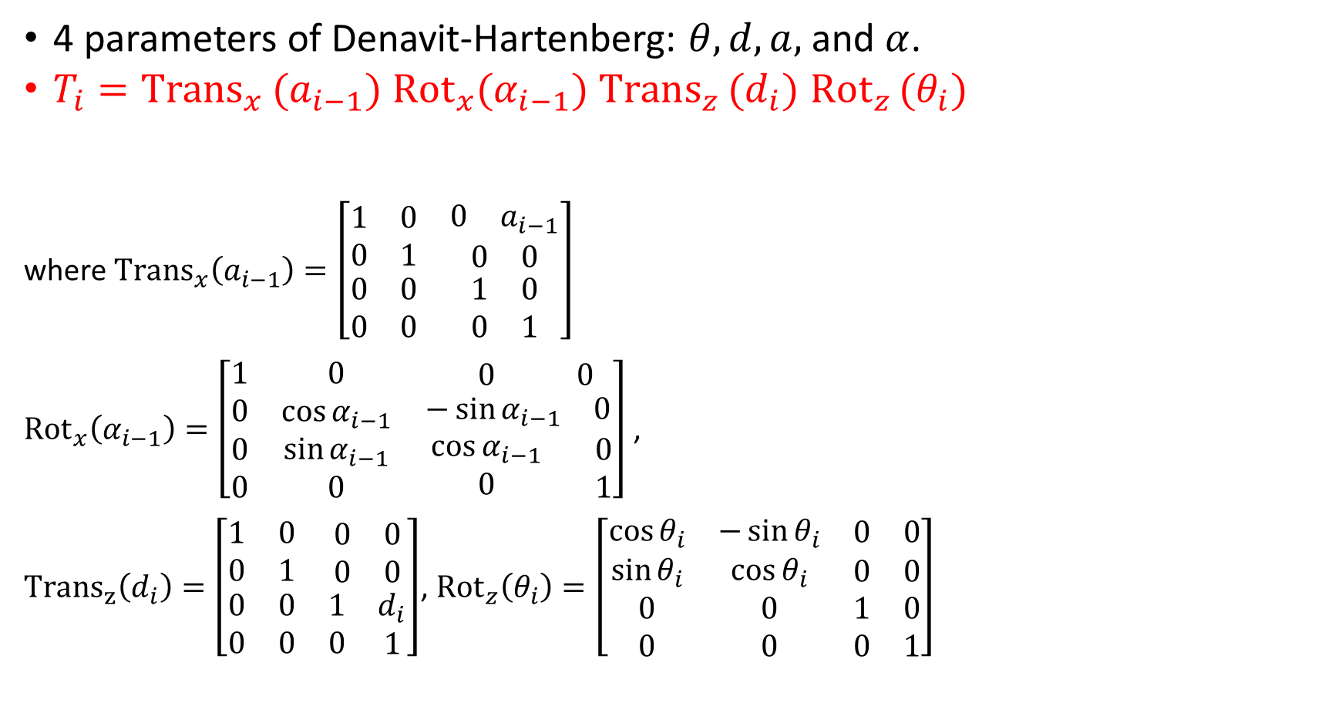
Denavit-Hartenberg Parameters
4 parameters of Denavit-Hartenberg: $θ, d, a,$ and $α$.
$T_{i}={Trans}_{x }(a_{i−1})$ ${Rot}_{x}(α_{i−1})$ $Trans_{z }(d_{i})$ $Rot_{z }(θ_{i})$
where ${Trans}_{x}\left(a_{i−1}\right)=\left[\begin{matrix}1 & 0 & \begin{matrix}0 & a_{i−1}\end{matrix} \\ 0 & 1 & \begin{matrix}0 & 0\end{matrix} \\ \begin{aligned}0 \\ 0\end{aligned} & \begin{aligned}0 \\ 0\end{aligned} & \begin{matrix}\begin{aligned}1 \\ 0\end{aligned} & \begin{aligned}0 \\ 1\end{aligned}\end{matrix}\end{matrix}\right]$
${Rot}_{x}\left(α_{i−1}\right)=\left[\begin{matrix}1 & 0 & \begin{matrix} 0 & 0\end{matrix} \\ 0 & \cos{α_{i−1}} & \begin{matrix}−\sin{α_{i−1}} & 0\end{matrix} \\ \begin{aligned}0 \\ 0\end{aligned} & \begin{aligned}\sin{α_{i−1}} \\ 0\end{aligned} & \begin{matrix}\begin{aligned}\cos{α_{i−1}} \\ 0\end{aligned} & \begin{aligned} 0 \\ 1\end{aligned}\end{matrix}\end{matrix}\right]$ ,
${Trans}_{z}\left(d_{i}\right)=\left[\begin{matrix}1 & 0 & \begin{matrix}0 & 0\end{matrix} \\ 0 & 1 & \begin{matrix}0 & 0\end{matrix} \\ \begin{aligned}0 \\ 0\end{aligned} & \begin{aligned}0 \\ 0\end{aligned} & \begin{matrix}\begin{aligned}1 \\ 0\end{aligned} & \begin{aligned}d_{i} \\ 1\end{aligned}\end{matrix}\end{matrix}\right]$, ${Rot}_{z}\left(θ_{i}\right)=\left[\begin{matrix}\cos{θ_{i}} & −\sin{θ_{i}} & \begin{matrix}0 & 0\end{matrix} \\ \sin{θ_{i}} & \cos{θ_{i}} & \begin{matrix}0 & 0\end{matrix} \\ \begin{aligned}0 \\ 0\end{aligned} & \begin{aligned}0 \\ 0\end{aligned} & \begin{matrix}\begin{aligned}1 \\ 0\end{aligned} & \begin{aligned}0 \\ 1\end{aligned}\end{matrix}\end{matrix}\right]$
!!!
Practice in MATLAB to illustrate the use of Homogenous transformation matrix

Slide 19


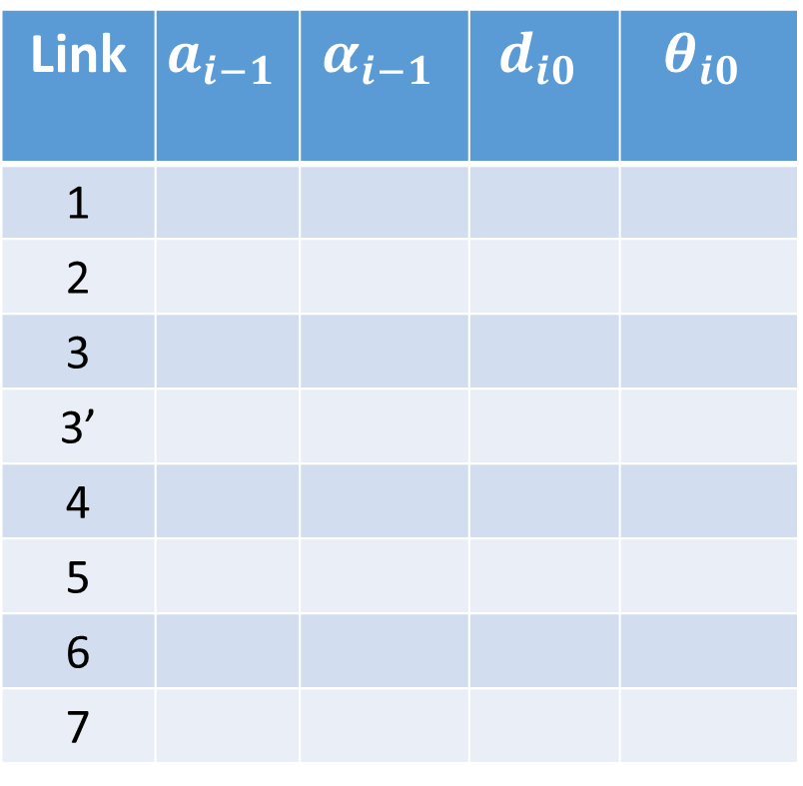
Denavit-Hartenberg Parameters
Homework (DO NOT use the axes shown in the schematic
Link | $$a_{i−1}$$ | $$α_{i−1}$$ | $$d_{i0}$$ | $$θ_{i0}$$
1
2
3
3’
4
5
6
7

